Slide 1
WISABI BANK ATM TRANSACTION ANALYSIS

Slide 2
Problem Statement
Wisabi Bank lacks visibility into ATM performance and customer behavior, leading to:
Frequent cash-outs at peak hours
Poor ATM resource distribution
Limited fraud detection
No clarity on revenue-driving ATMs
Weak insights into customer usage patterns

Slide 3
Objective
Use data-driven analytics to:
Identify high-volume ATMs and regions
Pinpoint peak usage hours and days
Track transaction types and top customers
Detect unusual or risky patterns
Optimize ATM operations and enhance customer experience

Slide 4
Key Components of the Dataset
Customer Information
ATM Location Details
Transactional Data
Transaction Type Data
Calendar Information

Slide 5
Data Analysis Process
Understanding transaction patterns and trends, and define objectives​
Data gathering and Data Preparation
Data Processing and Analysis
Visualization, generating insights and Recommendations.​

Slide 6
Dataset Overview
Total 5 transactional tables having comprehensive view of the bank's ATM operations across all locations
The Location Table provides details about ATM locations, ID, Name, no. of ATMs, City, State, and Country
The customers dimensions table contains information about cardholders
Transaction type dimension table defines different transaction types and names
The hour table captures hour-related details
The calendar dimension contains date-related information.

Slide 7
Tools and Why They were used
Excel – Data Familiarization
Conducting preliminary checks and reviewing column structures
Performing quick validations to ensure accuracy of raw banking data
Exploring datasets to identify patterns and anomalies
2. SQL Server – Data Foundation
Cleaning and transforming raw inputs into structured formats
Writing optimized queries and establishing relationships across tables

Slide 8
3. Power BI – Insight Generations
Importing curated datasets for advanced visualization.
Designing interactive dashboards for dynamic exploration.
Delivering executive – ready insights to track performance and trends.
4. Power-Point – Executive Communication
Presenting complex analytics in a clear, concise format.
Storytelling with data to connect insights to business outcomes
Highlighting key recommendations and strategic impact of decision-making.

Slide 9
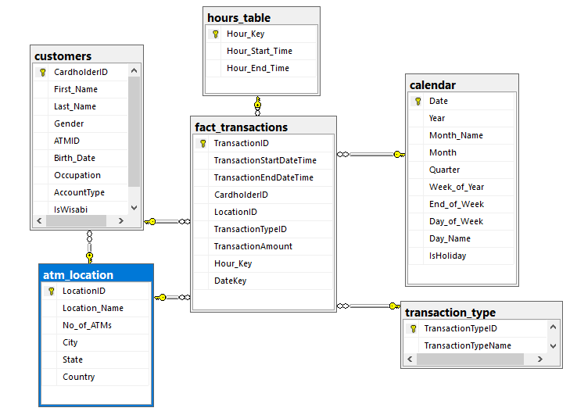
ER DIAGRAM

Slide 10
KEY PERFORMANCE INDICATORS
Transaction Volume
Transaction Value
Cash Outflow
Cash Flow
2.14 Millions
38.56 billions
26 billions
3 billions
Total ATMs
Total Customers
Total Locations
Cash In-Flow
131
8819
50
10 billions

Slide 11
What we analysed
Descriptive Analysis
Diagnostic Analysis
ATM Utilization & Service Efficiency
Transaction Trends across Time
Transaction Type Analysis
Customer Segmentation & Usage Behavior
Geographic Footprint & Infrastructure Performance
Seasonality and Periodic Demand Patterns
ATM Underutilization Analysis
Customer Segment Impact
Holiday Transaction Behavior
State-wise ATM Demand Variation
Transaction Duration root Cause
Wisabi vs Non-Wisabi Behavior

Slide 12
Descriptive Analysis
Understand what happened across the ATM Network

Slide 13
ATM Utilization & Service Efficiency
Top ATM – Likki
Top State – Lagos
Total Value – 10.3 Billions
Total Volume – 55K
Total Value – 14.3 Billions
Total Volume – 75K
Highest Transactions
Kano - 55K

Slide 14
Transaction Trends across Time
Peak Transaction Hour 3-6 PM
Peak Transaction Day – Thursday – 0.3 M
Peak Transaction Month – March – 0.1 M
Highest Transaction Quarter – Q1 – 0. 5 M
Week days having highest Transactions – 1.8 M

Slide 15
Customer segment & Usage Behavior
Account Type
Top Age Group
Gender Split
Savings – 1.21 M
Current - 934K
25- 34 Years
0.7 M txns
Male – 1.072 M txns
Fe Male – 1.07 M txns
Wisabi vs Non-Wisabi
Transaction Volume – 1.72 M (80%)
Transaction Value – 3.10 B
Wisabi
Transaction Volume – 0.42 M (40%)
Transaction Value – 0.76 B
Non - Wisabi

Slide 16
Seasonality and Periodic Demand Patterns
Holiday vs Non-Holiday
Non –Holiday Avg Transactions – 5876
Holiday Transactions – 5720
High/Low Transaction Day
High - 2022-03-03 – 11726 Transactions
Low - 2022-12-02 – 5560 Transactions
Top – Q4 –Volume [ 0.54 M ] & Value [ 9.71 B ]
Low – Q2 – Volume [ 0.53 M ] & Value [ 9.54B ]
Top & Low Quarter

Slide 17
Diagnostic Analysis
Why is it Happening

Slide 18
Underutilization & Customer Segment Impact
Highly Utilized ATM
Sabon Gari ATM
26K+ Transactions per ATM
Serving 125 Customer each
Lowest Utilized ATM
FCT Abuja ATM
6K Transactions per ATM
Serving 9 Customer each
Lowest Unique Customers
Garki ATM (33),
Lugbe (37) & Maitama (44)

Slide 19
Transaction Pattern Wisabi vs Non-Wisabi
Wisabi Customers
Non – Wisabi Customers
17 M total transactions
₦ 30.98 Billions total value
4 times more holiday transactions
Sabon Gari ATM: top location
Weekday-heavy: 1.48M
245K weekend
Active across all transaction types
0.4 M total transactions
₦ 7.57 Billions total value
Only 9,015 holiday transactions
Spread more evenly across ATMs
Weekday-heavy: 361K vs 60K weekend
Lower engagement in all categories

Slide 20
Target Audience & Benefits
ATM Operations
Replenishment Planning, Overload prevention, uptime improvement
Regional Business
Seasonal Demand, expansion Business
Marketing Team
Age Occupation Targeting, Wisabi Onboarding Campaigns
Strategy Team
Demand Forecasting, High Growth Markets
Finance Dept
ROI Per ATM, Revenue Tracking, Budget Allocation

Slide 21
Recommendations
Some of the recommendations based on the generated insights are:
Consider increasing ATM availability.
Optimize maintenance schedules to minimize downtime
Add more ATMs in cities with fewer machines but high transaction volumes.
Do cash reserve planning this approach can minimize the cash shortage risk during peak transaction months
Develop and promote seasonal financial products.
Develop an offer financial products and services for their specific needs of the students.
Highlight specific services that align with the transaction behaviors of each occupation.
Actively seek feedback from customers of different occupations.

Slide 22
THANK Y0U

